Slide 1
Status of the Electromagnetic Calorimeter for SBS/GEp5 at Hall A JLab
Shahinyan

Slide 2
Outline
Super BigBite Spectrometer
SBS/ GEp5 experiment
First thermal test a block of LG
Test run of ECal 16 channels in 2015
First thermal test of ECal prototype
Second thermal test of ECal prototype
Test of cooling system of prototype

Slide 3
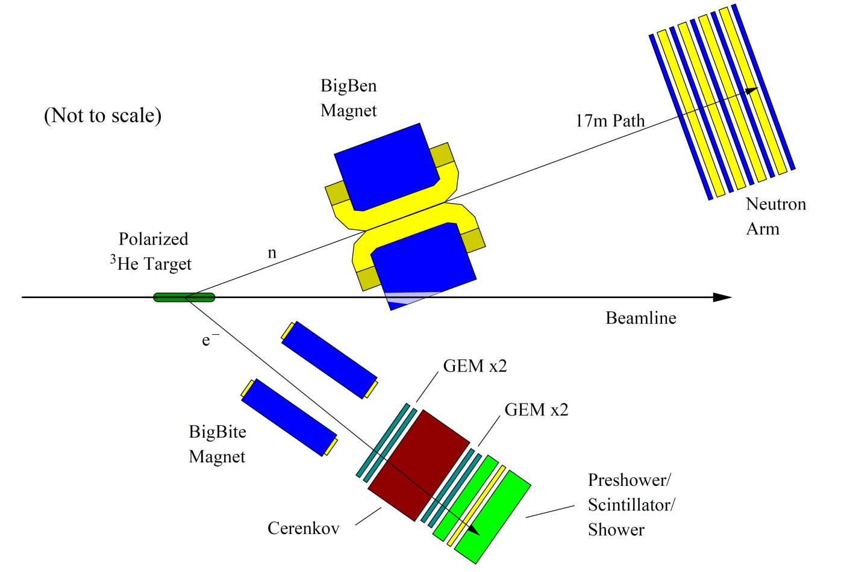
Super BigBite Spectrometer

Slide 6
GEP5 - Large Acceptance Proton Form Factor Ratio Measurements at 13 and 15 (GeV/c)² using Recoil Polarization Method
GEP5 Layout

Slide 7
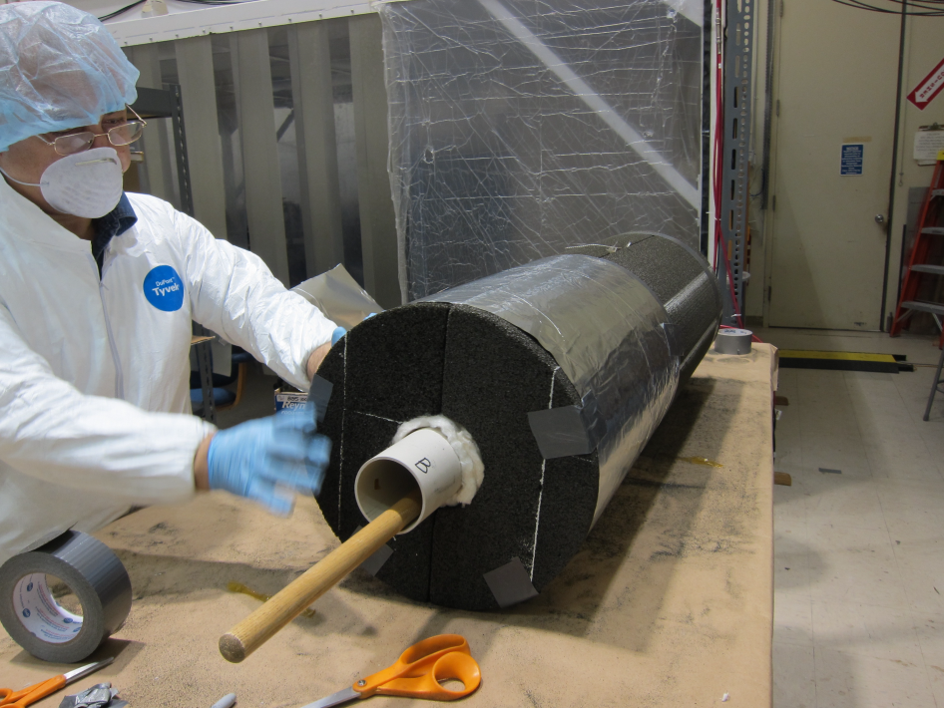
The ECAL blocks under heat treatment
Irradiated (14 kRad) at ISU
after heat at 200ºC, 2 hours
after heat at 225ºC, 1 hour

Slide 8
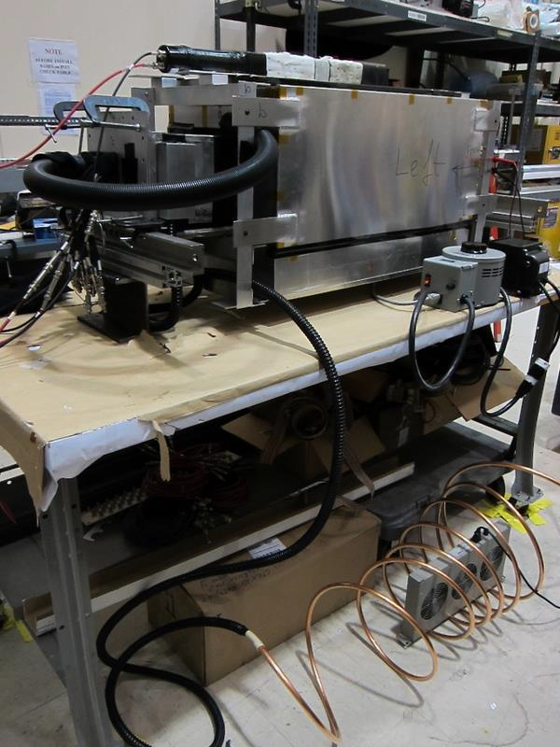
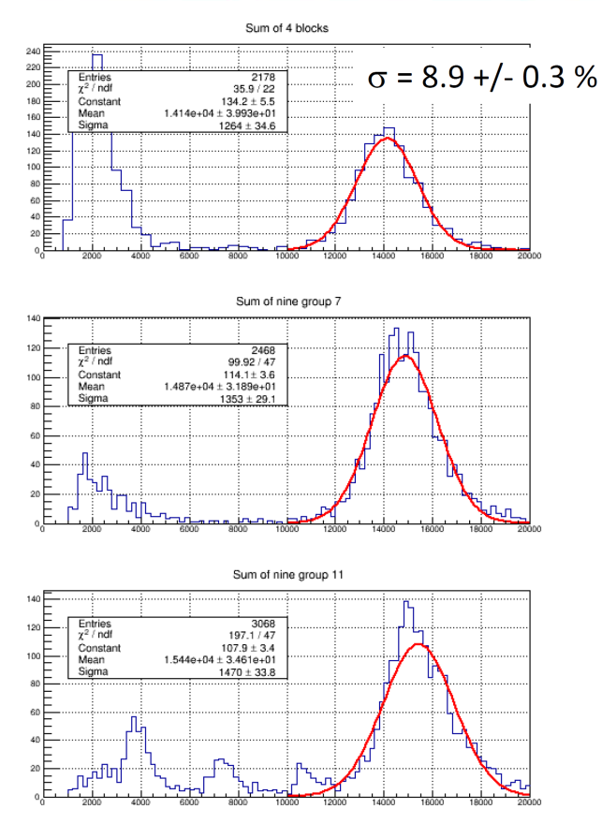
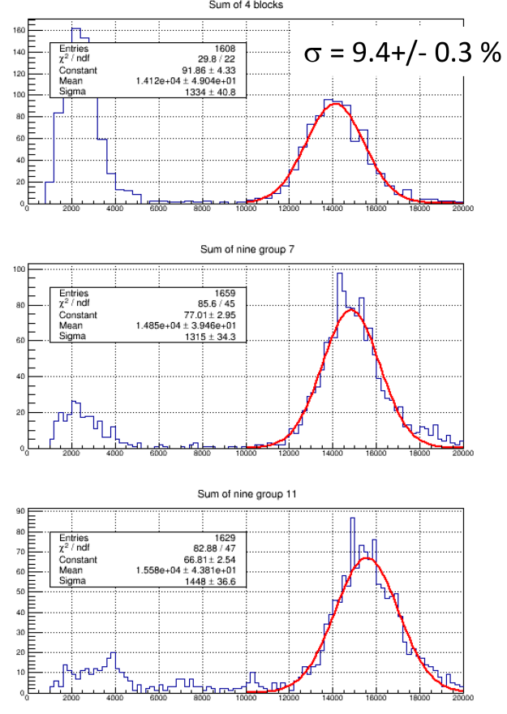
16 Channel Test Run
Test run done in 2015.
Required temperature setting at the front and back of lead glass blocks were determined (225℃ at the front, 185℃ at the back).
Annealing at these temperatures keeps resolution nearly constant.
Cool air blows in back to cool PMT

Slide 9
First ECal prototype test
Prototype with foam-glass
Prototype consists of 9 SM-s
1 heating tape attached to 3 SM-s
Heater power 830 W at 120 V

Slide 10
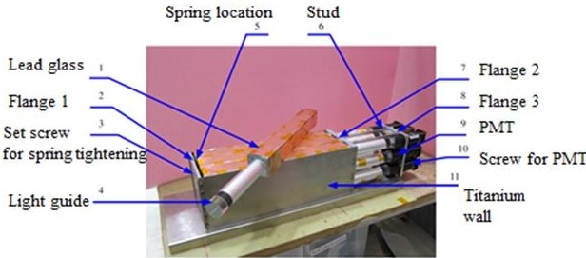
ECal SuperModule

Slide 11
ECal prototype test setup Schematic view
Front and side view
Thermocouple position
T1 – on flange 1
T2 – on flange 5
T3 – on flange 8
T4,5,6 – on LG front
T7,8,9 – on LG middle
T10,11,12 - on LG back
T13-on Light guide

Slide 12
First test results
All heaters were fed from variable transformers
Heaters were attached to the front of SM-s, via perforated Al
The perforated Al was attached to the front flange via ¼” thick Al bar
At ~185 ℃ on the back of the lead glass block, temp. at the front
of the lead glass block reached 250 ℃.
At these conditions, temp. of the front flange was 360 ℃.
Voltage at heaters was 57 V (total power 560 W).
Temp-s of light guides reached 70 ℃.
Results are not satisfactory, decided to conduct another test.

Slide 13
ECal Prototype
Prototype covered with foam-glass
Front view
Prototype covered with foam-glass
Back view

Slide 14
Objectives of the 2-nd test
After data analysis of the 1-st test, in order to achieve boundary temp-s 225℃ and 185 ℃ it was decided to heat blocks from sides as well.
For the side heating, bars of high thermo-conductivity Al of 6063 type, of 1”x2” cross section, of lead glass block + 4” length were used.
2-nd prototype consisted of 6 SM-s.
Against sides of SM-s 2 Al bars and 1” spacer was pressed.

Slide 15
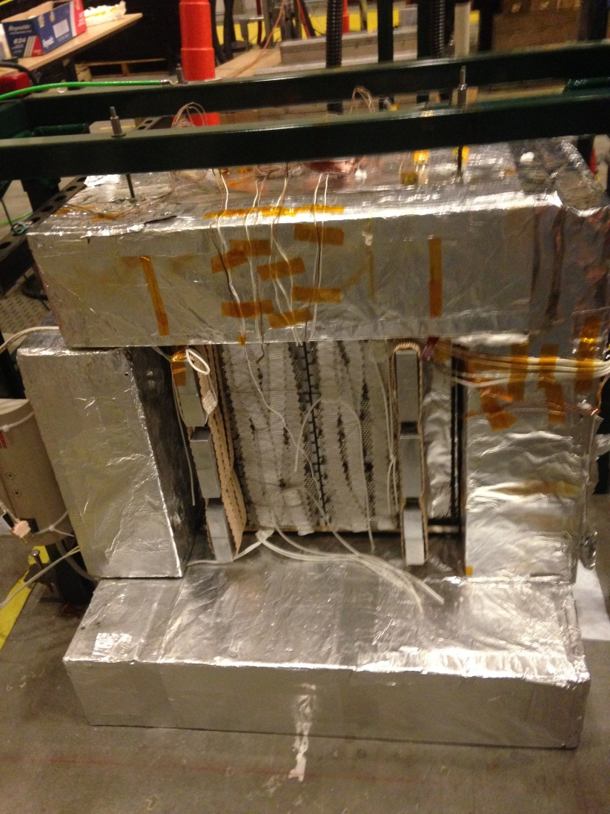
ECal prototype second test setup

Slide 16
2-nd Test Results
Achieved 250 ℃ at the front flange of SM
At the front of lead glass block ~225 ℃
At the back of lead glass block ~185 ℃
At the end tip of the light guide ~70 ℃
Heater voltage was 45 V, total power output 465 W
Light guide cooling is needed.

Slide 17
Prototype Cooling System
Install 8 thermocouples
Blower off max temperature was 70 degree C
Blower off transformer output 45 V
Blower on max temperature was 35 degree C
Blower on transformer output 48 V
Thermocouple position on the light guide

Slide 18
Cooling system setup
Pressure of the blower 12” water

Slide 19
Conclusion
First Test
Front flange temperature 360 degree C
Front lead glass block temperature 250 degree C
Back lead glass block temperature 180 degree C
Light guide temperature 70 degree C
Transformer output 57 V
Second test
Front flange temperature 250 degree C
Front lead glass block temperature 220 degree C
Back lead glass block temperature 187 degree C
Light guide max temperature 35 degree C with blower on
Transformer output 48 V
Necessary power for 1 SM is 90 W

Slide 20
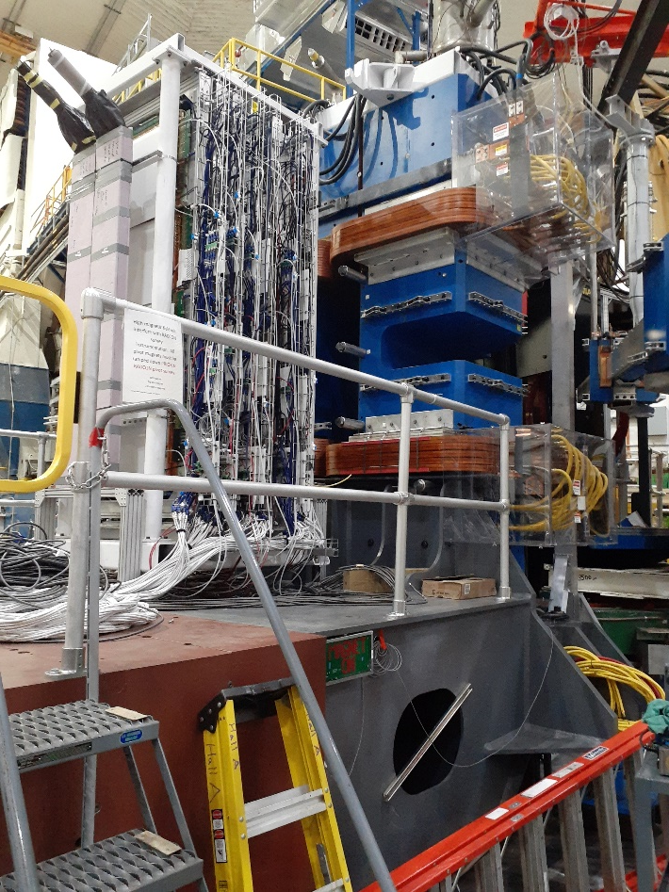
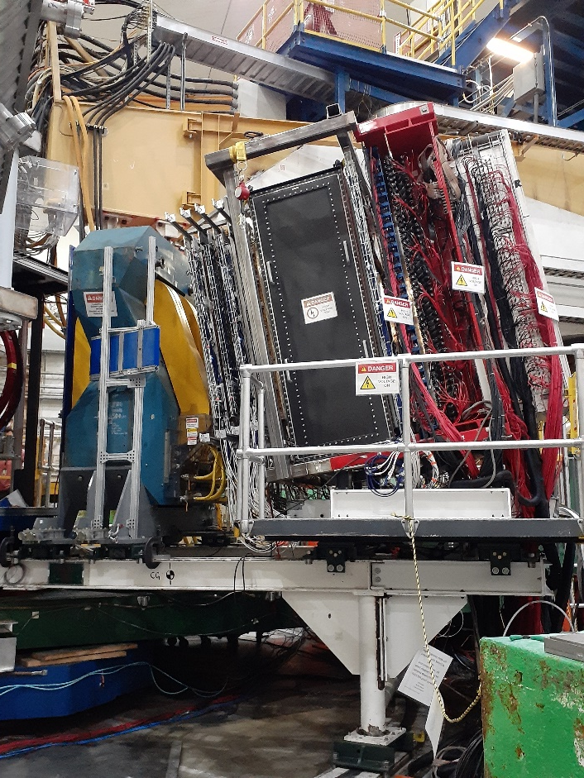
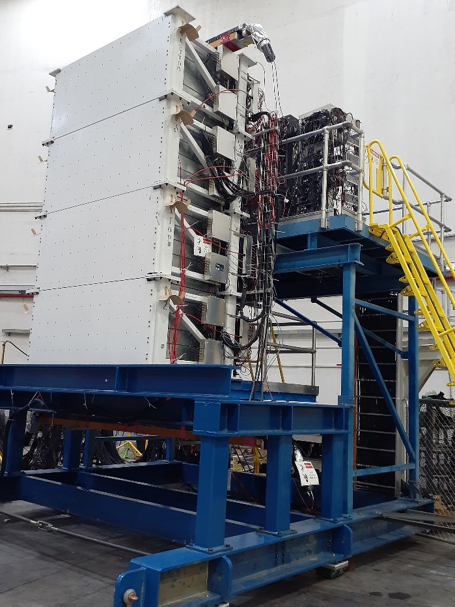
SBS detector package for GMN experiment
SBS and GEM
BigBite
HCAL

Slide 21
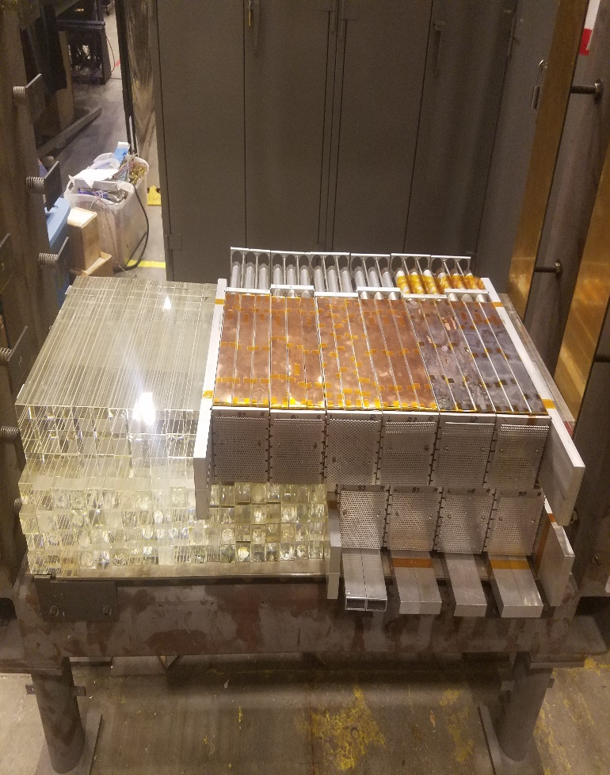
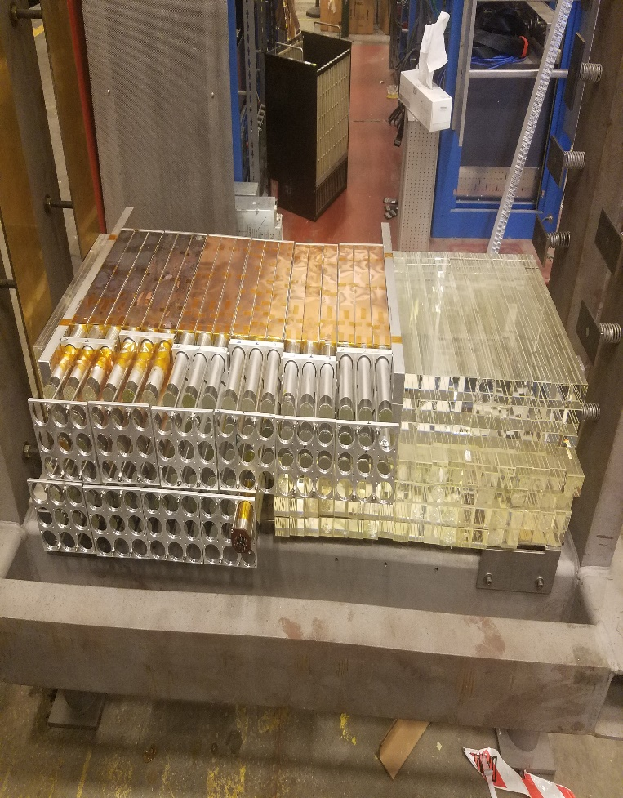
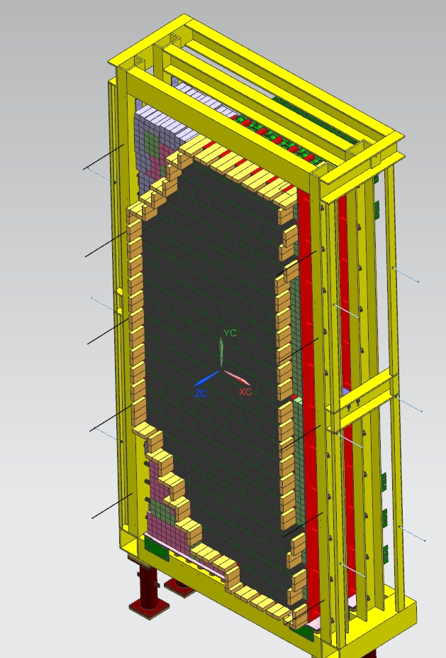
SBS/Ecal Frame
Ecal Frame with 2 layer
Super Module front
Ecal Frame with 2 layer
Super Module back
Ecal Frame with
Super Module 3D

Slide 22
ՇՆՈՐՀԱԿԱԼՈՒԹՅՈՒՆ

Slide 23
Thanks Iuliia

